Slide 1
Features Extraction In Computer Vision
By Salman Ahmad Khan

Slide 2
Features Extraction
In machine learning, pattern recognition and in image processing, feature extraction starts from an initial set of measured data and builds derived values (features) intended to be informative and non-redundant, providing better human interpretations.
When the input data to an algorithm is too large to be processed and it is suspected to be redundant (e.g. images presented as pixels),
then it can be transformed into a reduced set of features (also named a "features vector"). This process is called feature extraction.
The extracted features are expected to contain the relevant information from the input data, so that the desired task can be performed by using this reduced representation instead of the complete initial data.

Slide 3
Feature Descriptors
Primary Feature Descriptors
Color Descriptors
Texture Descriptors
Shape Descriptors

Slide 4
A. Color Descriptors
Conventional color histogram (CCH)
Easy computation
Does not encode spatial info
Does not encode color pixel similarity
Color Structure Descriptor
Populates a histogram by taking local distributions of colors in the image
Dominant Color Descriptor
Encodes dominant colors into triads of color values, percentages of colors and their variances

Slide 5
1. Conventional Color Histogram
Red | Green | Blue | Pixel Count
0 | 0 | 0 | 7414
0 | 0 | 1 | 230
0 | 0 | 2 | 0
0 | 0 | 3 | 0
0 | 1 | 0 | 8
0 | 1 | 1 | 372
0 | 1 | 2 | 88
0 | 1 | 3 | 0
0 | 2 | 0 | 0
0 | 2 | 1 | 0
0 | 2 | 2 | 10
… | … | … | …
3 | 2 | 3 | 109
3 | 3 | 0 | 0
3 | 3 | 1 | 0
3 | 3 | 2 | 3415
3 | 3 | 3 | 53929
A color histogram is a representation of the distribution of colors in an image
It shows different types of colors appeared and the number of pixels in each type of the colors appeared
Color histogram focuses only on the proportion of the number of different types of colors, regardless of the spatial location of the colors
Number of colors are usually reduced for easy computation
For example: A color histogram in the RGB color space can be represented using four bins. Bin 0 corresponds to intensities 0-63, bin 1 is 64-127, bin 2 is 128-191, and bin 3 is 192-255.

Slide 6
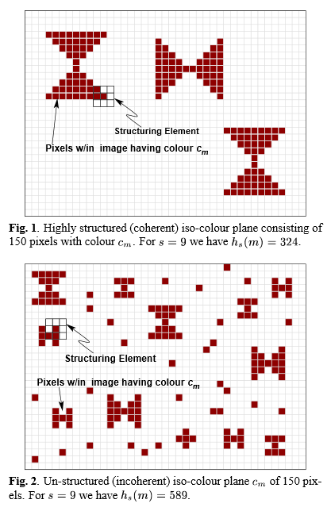
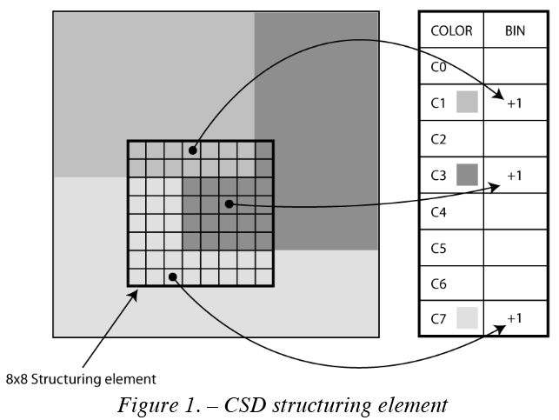
2. Color Structure Descriptor
It expresses local color structure in an image by use of a structuring element
The CSD is computed by visiting all location in the image, retrieving colors C{0-7} of all pixels contained in the 8x8 pixel structure element.
CSD bine of each color contained inside the window are incremented.

Slide 7
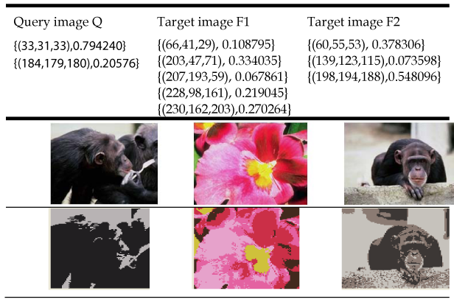

3. Dominant Color Descriptor
The dominant color descriptor is defined as:
F={Ci, Pi}, (i=1,2,3…N)
Where Ci is a 3D dominant color vector, Pi is the percentage of each dominant color.
C = 9*H + 3*S + V; C∈[0，71]
Calculate the quantified HSV space histogram, with Pi (i=0,1,,71) express proportion of color vector i;
Similarity measure:

Slide 8
B. Texture Descriptors
Statistical Texture Features
Smoothness
Coarseness
Regularity
Edge Histogram Descriptor
Represent textures by local edge characteristics
Local Binary Patterns (LBP) Histogram
Rotated Local Binary Patterns (RLBP) Histogram
5. Local Ternary Patterns (LTP)

Slide 9
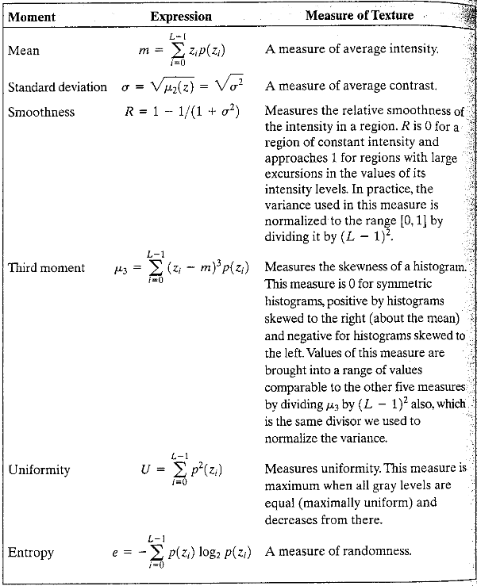
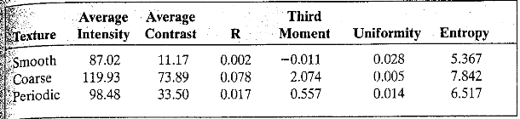
1. Statistical Texture Features

Slide 10
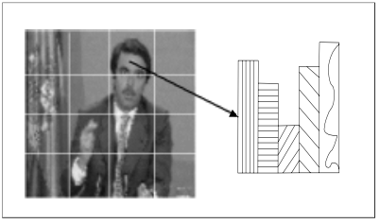
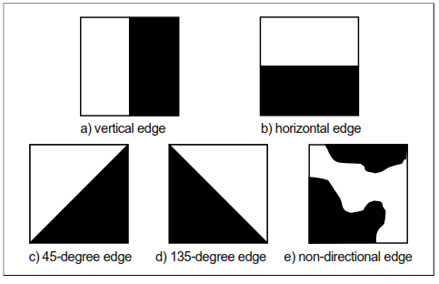
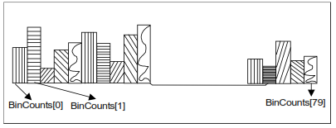
2. Edge Histogram Descriptor
Edges in images constitute an important feature to represent their content.
Human eyes are sensitive to edge features for image perception.
Divide the image into 4x4 regions. Compute edge pixels for each edge type and populate a histogram
For 16 subimages, 80 bin histogram is obtained. This histogram is referred to as Edge Histogram Descriptor or Edge Orientation Histogram.
Five type of edges

Slide 11
3. Local binrary patterns (LBP):
3x3 neighborhood
Thresholds
Weights
66
65
62
1
0
0
32
64
128
67
66
61
1
0
16
1
69
68
67
1
1
1
8
4
2

Slide 12
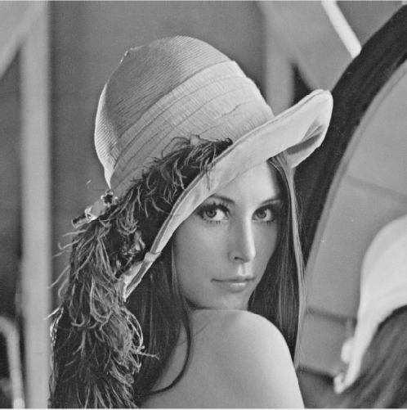
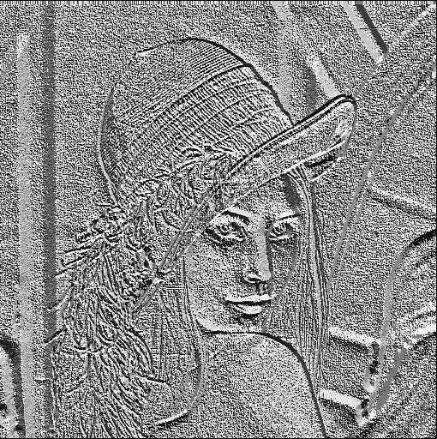
Effect of local binrary pattern:

Slide 13
4. Rotate Local Binary Patterns (RLBP)
3x3 neighborhood
Thresholds
Weights
66
65
62
1
0
0
4
8
16
67
66
61
1
0
2
32
69
68
67
1
1
1
1
128
64

Slide 14
4. Rotate Local Binary Patterns (RLBP)
3x3 neighborhood
Thresholds
Weights
66
65
62
1
0
0
16
32
64
67
66
61
1
0
8
128
69
68
72
1
1
1
4
2
1

Slide 15
Effect of rotation on LBP and RLBP operator:

Slide 16
5. Local Ternary Pattern (LTP)

Slide 17
C. Shape Descriptors
Fourier Descriptors
Fourier shape descriptors are calculated by applying Fourier Transform on 1D shape signatures discussed previously which are usually derived from the shape’s contour
Histogram of Oriented Gradients (HOG) Features
Scale-invariant Feature Transform (SIFT) Features
Speeded Up Robust Features (SURF)

Slide 18

1. Fourier Descriptors
The Fourier shape descriptors are calculated by applying Fourier Transform on 1D shape signatures discussed previously which are usually derived from the shape’s contour.
The Fourier coefficients obtained a_{n} (also called FDs) are normalized by using the DC component of the transform as
Where FD1 is the DC component, and FD_{N} are the Fourier coefficients.

Slide 19
2. Histogram Oriented Gradient (HOG)
Histogram of oriented gradients
Navneet Dalal and Bill Triggs
HOG is a dense feature extraction method for images. Dense means that it extracts features for all locations in the image (or a region of interest in the image).
It tries to capture the shape of structures in the region.

Slide 20
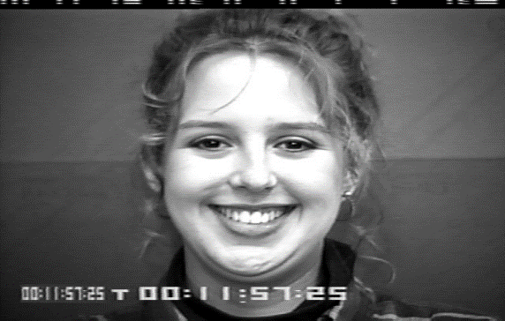
HOG Descriptor Calculation
Let’s compute HOG descriptor for the following 128 x 128 image.
128 pixels
128 pixels

Slide 21
HOG Computation
We start with computing X-gradient and Y-gradient of the image
X’
Convolution with [-1 0 1]
128 pixels
128 pixels
Convolution with [-1 0 1] ’
Y’

Slide 22

HOG Computation
We then compute a new matrix with a gradient magnitudes
X’
For each pixel (i, j)
$$\left|M\right|=\sqrt{{\left({X′}_{(i,j)}\right)}^{2}+{\left({Y′}_{(i,j)}\right)}^{2}}$$
Gradient Magnitudes
Y’

Slide 23

HOG Computation
And another matrix with the gradient orientations
X’
Gradient Directions
For each pixel (i, j)
$$θ=arctan⁡\left(\frac{{Y′}_{(i,j)}}{{X′}_{(i,j)}}\right)$$
Y’

Slide 24
HOG Computation
Now we start computing the HOG vector
Lets start with the first Block sized 16x16 pixels

Slide 25
HOG Computation
We divide this block into 2x2 Cells sized, 8x8 pixels each
Let starts with first Cell sized 8x8 pixels
16 pixels
16 pixels
A block

Slide 26
HOG Computation
We compute a 9-bins histogram by using gradient directions and magnitudes we’ve already computes
8 pixels
Gradient Magnitudes
8 pixels
8 pixels
Gradient Orientations
8 pixels

Slide 27
HOG Computation
We continue with computing 9-bins histograms also for the rest of the cells in the block …
16 pixels
16 pixels
A block

Slide 28
HOG Computation
Finally, concatenated the 9 cell’s histograms into
one 36-sized vector.
As the block contains 4 cells,
we have 4 histograms with 9 bins
each. We simply concatenate them
into one 36 –sized vector
V1
V2
V3
.
.
.
.
V36
……

Slide 29
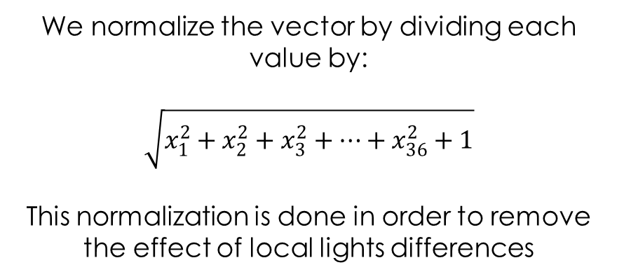
HOG Computation
Normalize the concatenated block’s vector
We normalize the vector by dividing each value by:
$$\sqrt{x_{1}^{2}+x_{2}^{2}+x_{3}^{2}+…+x_{36}^{2}+1}$$
This normalization is done in order to remove the effect of local lights differences

Slide 30
HOG Computation
We continue the same way with the rest of the blocks while blocks are 50% overlapping
…
…

Slide 31
HOG Computation
For example there are total of 60 blocks
Concatenate their 36 sized vector into a 2160 sized final vector
V1
60 vectors, 36 sized each
Final vector size
60*36=2160
V2
+
+ … +
V3
.
.
.
.
V2160

Slide 32
3. Scale-invariant Feature Transform (SIFT)

